Slide 1
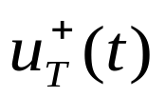



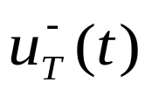

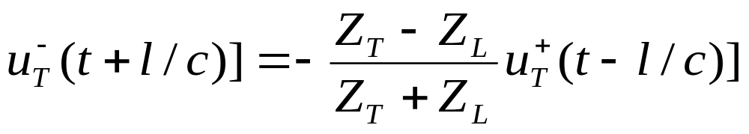
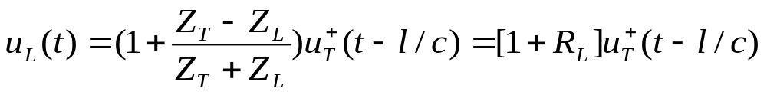
Boundary condition (lips)
TUBE
[Vocal track]
Z_{L}
Glottis
Lips

Slide 2


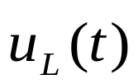



TUBE
[Vocal track]
Z_{L}
Glottis
Lips
_{Delay}
_{Delay}

Slide 3

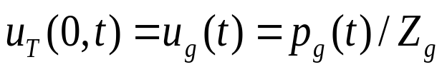
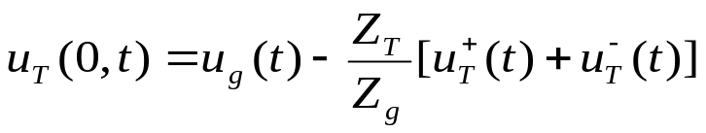
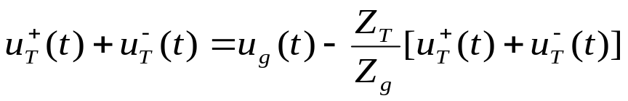
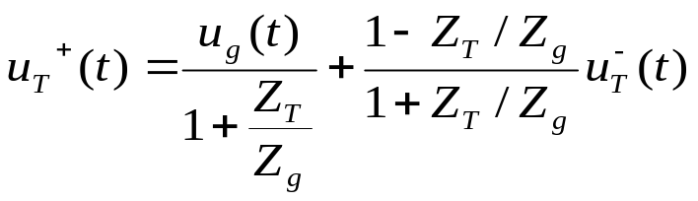
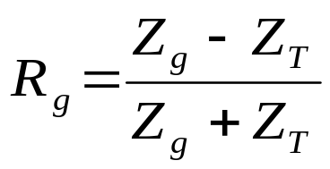
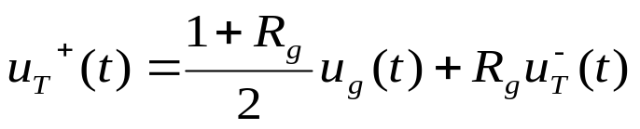
Boundary condition (glottis)
TUBE
[Vocal track]
Z_{L}
Z_{g}
Glottis
Lips

Slide 4

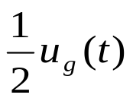






Boundary condition (glottis)
TUBE
[Vocal track]
Z_{L}
Z_{g}
Glottis
Lips
Delay
Delay
If Z_{g}>>0 then R_{g}=1

Slide 5

Boundary condition (glottis)
TUBE
[Vocal track]
Z_{L}
Z_{g}
Glottis
Lips
Delay
Delay

Slide 6
Lecture-8
Sound Propagation in the Concatenated Tube Model

Slide 7
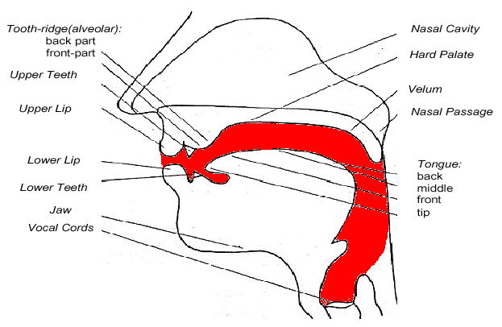
Speech Production System

Slide 8
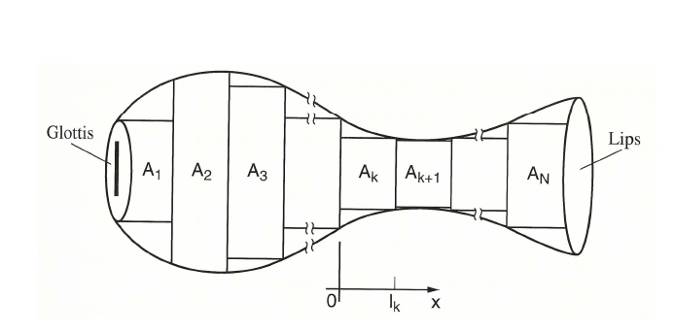

Slide 9
Concatenated Tubes
Glottis
A₁
A₂
A₃
A₄
A₅
Lips
l₁
l₅
l₄
l₂
l₃

Slide 10








Wave Propagation at the Junction
l_{k}
k^{th} tube
(k+1)^{th} tube

Slide 11




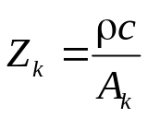
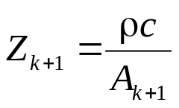
Wave Propagation at the Junction
k^{th} tube
(k+1)^{th} tube

Slide 12

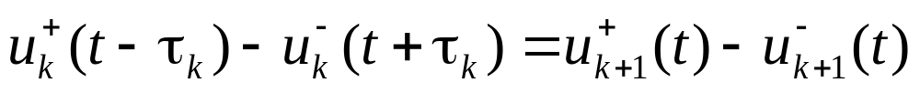
k^{th} tube
(k+1)^{th} tube

Slide 13
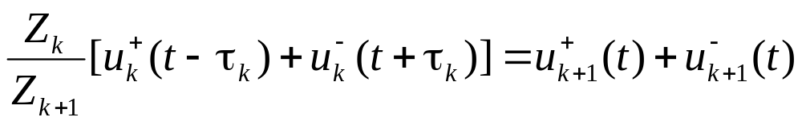
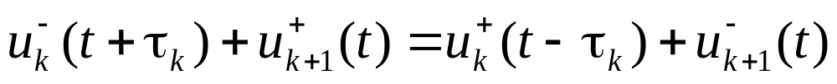
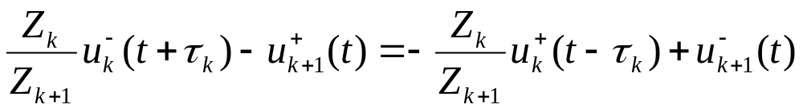
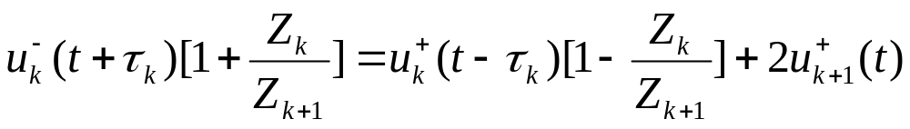
1
2
From equation 1
From equation 2
+

Slide 14
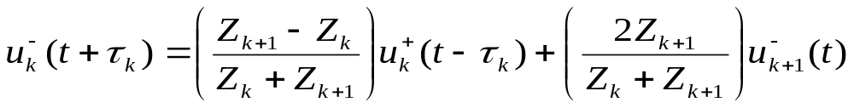
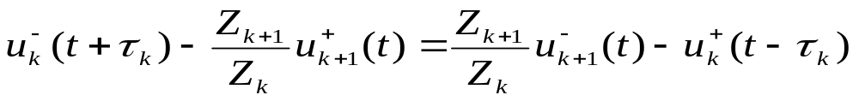
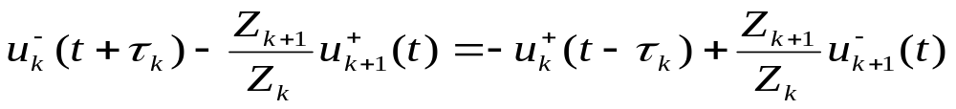
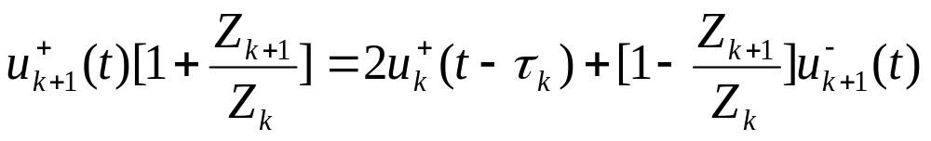
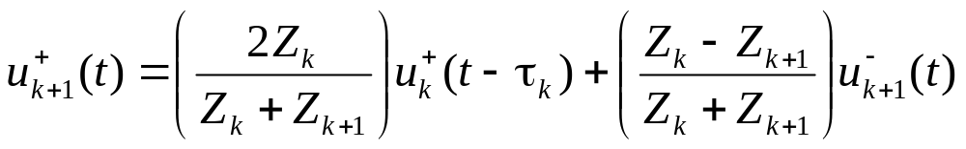
-

Slide 15
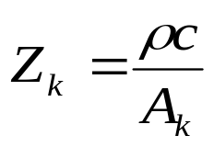
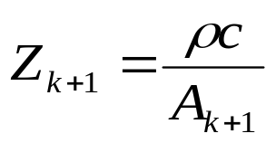
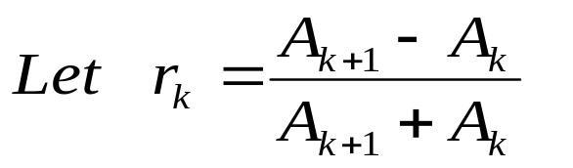
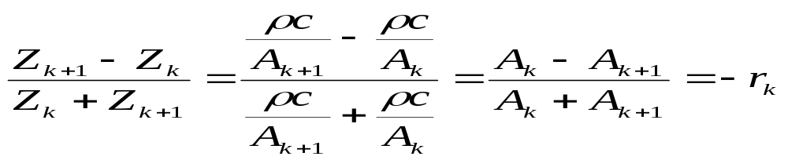
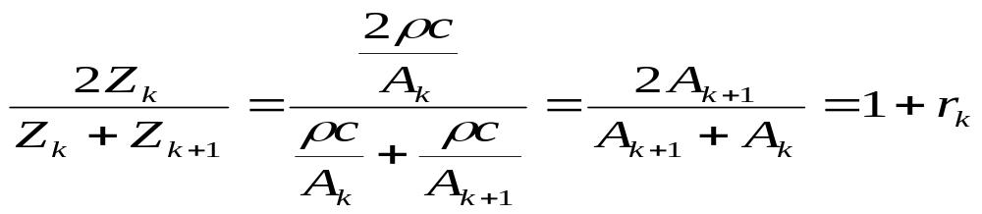
and
As a reflection coefficient

Slide 16
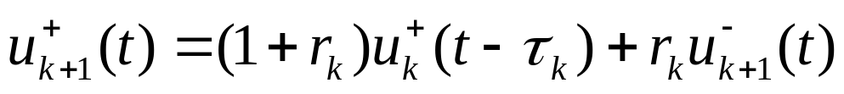

Slide 17
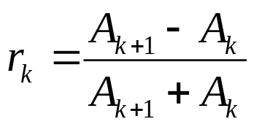
−r_{k}
r_{k}
k^{th} tube
r_{k} > 0: A_{k+1}> A_{k}
(k+1)^{th} tube
r_{k} < 0: A_{k+1}< A_{k}

Slide 18


Delay
τ_{k}
Delay
τ_{k+1}
1+r_{k}
−r_{k}
r_{k}
Delay
τ_{k}
1−r_{k}
Delay
τ_{k+1}

Slide 19
Equal Spaced Tubes
Delay
τ_{k}
Delay
τ_{k+1}
1+r_{k}
−r_{k}
r_{k}
Delay
τ_{k}
1−r_{k}
Delay
τ_{k+1}
τ₁
τ₂
τ₃
τ₄
τ₅
τ₁= τ₂ = τ₃= ⋅⋅⋅ = τ
Δx
Δx
Δx
Δx
Δx

Slide 20
Equal Spaced Tubes
Let sampling period T₁= τ
Delay
τ_{k}
z⁻¹
Delay
τ_{k+1}
z⁻¹
1+r_{k}
−r_{k}
r_{k}
Delay
τ_{k}
1−r_{k}
z⁻¹
Delay
τ_{k+1}
z⁻¹
τ₁
τ₂
τ₃
τ₄
τ₅
τ₁= τ₂ = τ₃= ⋅⋅⋅ = τ
Δx
Δx
Δx
Δx
Δx

Slide 21


Vocal Tract Model
Let sampling period T₁= τ
Delay
τ_{k}
z⁻¹
Delay
τ_{k+1}
z⁻¹
1+r_{k}
−r_{k}
r_{k}
Delay
τ_{k}
1−r_{k}
z⁻¹
Delay
τ_{k+1}
z⁻¹
0.5(1+r_{g})
z⁻¹
1+r₁
z⁻¹
1+r₂
z⁻¹
1+r_{N−1}
z⁻¹
r_{g}
−r₁
r₁
−r₂
r₂
−r_{N−1}
r_{N−1}
1+r_{l}
z⁻¹
1−r₁
z⁻¹
1−r₂
z⁻¹
1−r_{N−1}
z⁻¹
−r_{l}

Slide 22



Vocal Tract Model
Let sampling period T₁= τ
Let sampling period T₂= 2τ
0.5(1+r_{g})
z⁻¹
1+r₁
z⁻¹
1+r₂
z⁻¹
1+r_{N−1}
z⁻¹
1+r_{l}
z^{N/2}
z⁻²
z⁻²
z⁻²
z⁻²
z^{N}
r_{g}
−r₁
r₁
−r₂
r₂
−r_{N−1}
r_{N−1}
−r_{l}
1−r₁
1−r₂
1−r_{N−1}
0.5(1+r_{g})
1+r₁
1+r₂
1+r_{N−1}
1+r_{l}
z^{−N}
z^{−N/2}
r_{g}
−r₁
r₁
−r₂
r₂
−r_{N−1}
r_{N−1}
−r_{l}
z⁻²
1−r₁
1−r₂
1−r_{N−1}
z⁻¹
z⁻²
z⁻¹
z⁻²
z⁻¹
z⁻²
z⁻¹
0.5(1+r_{g})
z^{−1/2}
1+r₁
z^{−1/2}
1+r₂
z^{−1/2}
1+r_{N−1}
z^{−1/2}
1+r_{l}
z⁻¹
z⁻¹
z⁻¹
z⁻¹
r_{g}
−r₁
r₁
−r₂
r₂
−r_{N−1}
r_{N−1}
−r_{l}
z⁻¹
1−r₁
1−r₂
1−r_{N−1}
z^{−1/2}
z⁻¹
z^{−1/2}
z⁻¹
z^{−1/2}
z⁻¹
z^{−1/2}

Slide 23
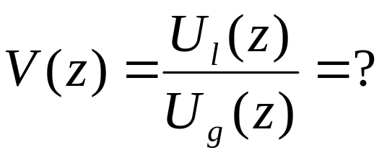
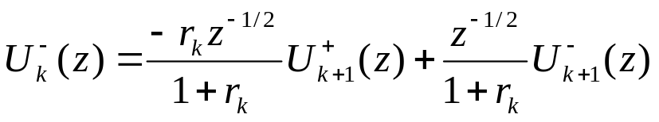

















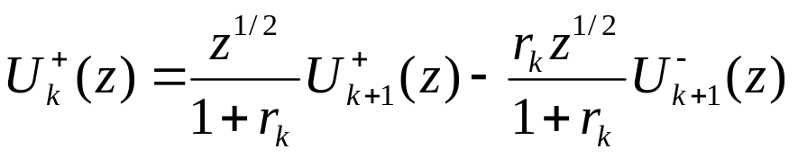
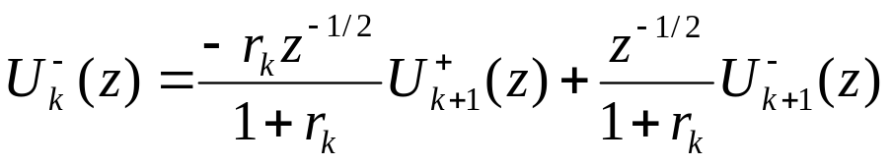
Impulse Response
0.5(1+r_{g})
z^{−1/2}
1+r₁
z^{−1/2}
1+r₂
z^{−1/2}
1+r_{N−1}
z^{−1/2}
1+r_{l}
r_{g}
−r₁
r₁
−r₂
r₂
−r_{N−1}
r_{N−1}
−r_{l}
z^{−1/2}
1−r₁
z^{−1/2}
1−r₂
z^{−1/2}
1−r_{N−1}
z^{−1/2}

Slide 24
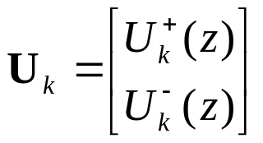

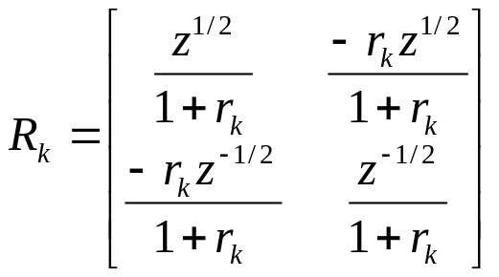
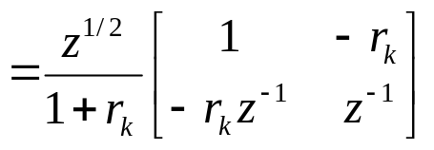
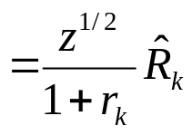
Impulse Response
0.5(1+r_{g})
z^{−1/2}
1+r₁
z^{−1/2}
1+r₂
z^{−1/2}
1+r_{N−1}
z^{−1/2}
1+r_{l}
r_{g}
−r₁
r₁
−r₂
r₂
−r_{N−1}
r_{N−1}
−r_{l}
z^{−1/2}
1−r₁
z^{−1/2}
1−r₂
z^{−1/2}
1−r_{N−1}
z^{−1/2}
Define

Slide 25
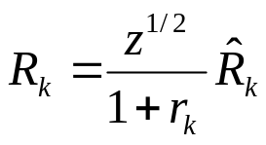
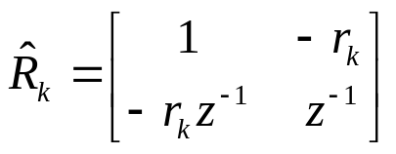








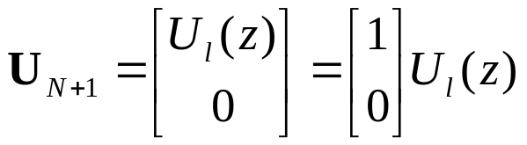

Impulse Response
0.5(1+r_{g})
1+r₁
1+r₂
1+r_{N−1}
1+r_{l}
(1+r_{N})
z^{−1/2}
z^{−1/2}
z^{−1/2}
z^{−1/2}
(−r_{N})
(r_{N})
r_{g}
−r₁
r₁
−r₂
r₂
−r_{N−1}
r_{N−1}
−r_{l}
z^{−1/2}
1−r₁
z^{−1/2}
1−r₂
z^{−1/2}
1−r_{N−1}
z^{−1/2}
(1−r_{N})
0
Define
Define

Slide 26

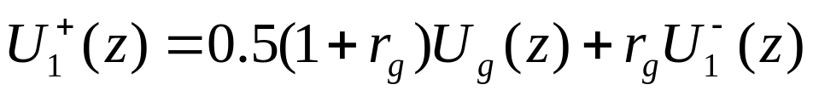
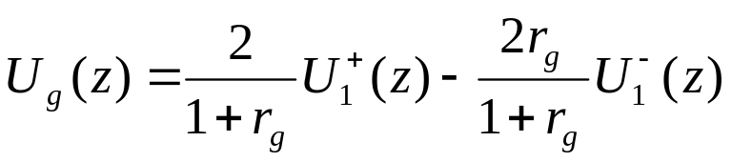
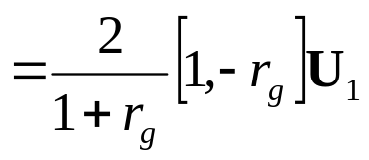
Impulse Response
0.5(1+r_{g})
1+r₁
1+r₂
1+r_{N−1}
1+r_{l}
(1+r_{N})
z^{−1/2}
z^{−1/2}
z^{−1/2}
z^{−1/2}
(−r_{N})
(r_{N})
r_{g}
−r₁
r₁
−r₂
r₂
−r_{N−1}
r_{N−1}
−r_{l}
z^{−1/2}
1−r₁
z^{−1/2}
1−r₂
z^{−1/2}
1−r_{N−1}
z^{−1/2}
(1−r_{N})
0

Slide 27
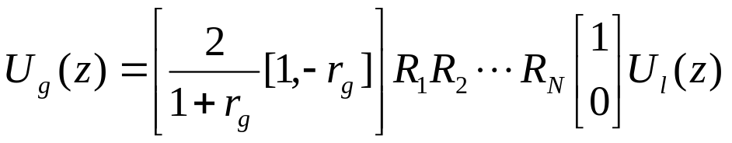
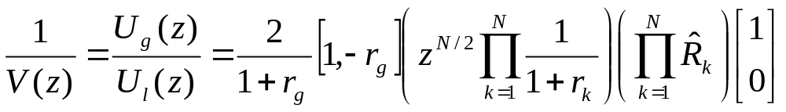
Impulse Response

Slide 28
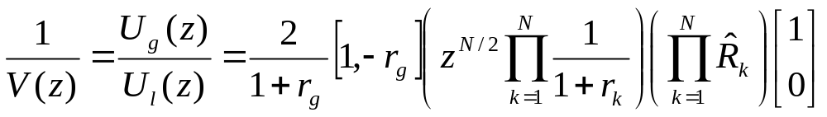




Two-Tube Model

Slide 29

Two tube model transfer function
one zero at origin
2nd order (2 poles)

Slide 30



N-Tube Model
one zero at origin
2nd order (2 poles)
All-pole Model
0.5(1+r_{G})
1+r₁
1+r₂
1+r_{N−1}
1+r_{L}
z^{−N/2}
r_{G}
−r₁
r₁
−r₂
r₂
−r_{N−1}
r_{N−1}
−r_{L}
z⁻¹
1−r₁
z⁻¹
1−r₂
z⁻¹
1−r_{N−1}
z⁻¹

Slide 31


Slide 32


Slide 33


Slide 34
Let length of the vocal tract l=17cm and the velocity of sound c=340m/s find the number of section required to generate 5 kHz bandwidth voiced signal

Slide 35
Lecture-9
Digital Models for Speech Signals

Slide 36


Direct Implementation
u_{g}[n]
G
u_{l}[n]
a₁
z⁻¹
z⁻¹
a₂
a_{N}
z⁻¹
Parameters
Linear System
V(z)
u_{g}[n]
u_{l}[n]

Slide 37













Poles of Vocal Tract Model
The roots of A(z) will be either real of occur in complex conjugate pairs.
Assume all poles are in conjugated pairs.

Slide 38












Slide 39






Formant Frequency and Bandwidth
Formant Frequency (θ_{k})
3 dB
Bandwidth
b_{k}

Slide 40








Cascade Implementation
G
Each Stage represents one formant frequency
and its corresponding bandwidth.
z⁻¹
z⁻¹
z⁻¹
z⁻¹
z⁻¹
z⁻¹

Slide 41
Digital Models for Speech Signals
Area Function
(Reflection Coefficient)
Lossless
Tube
Model
u_{g}[n]
u_{l}[n]
Speech
Signal
Excitation
Source
Parameters
Linear System
V(z)
u_{g}[n]
u_{l}[n]

Slide 42
Speech Production Model
F₀
A_{v}
Impulse
Train
Generator
Glottal
Pulse
G(z)
Vocal Track
Parameters
Voiced Sound
u_{G}[n]
Vocal Track
V(z)
u_{L}[n]
Lip
Radiation
R(z)
p_{L}[n]
Unvoiced Sound
Random
Noise
Generator
A_{N}

Slide 43



Radiation
Vocal Track
Parameters
u_{G}[n]
Vocal Track
V(z)
u_{L}[n]
Lip
Radiation
R(z)
p_{L}[n]
A High-Pass Filter

Slide 44



Excitation
F₀
Impulse
Train
Generator
Glottal
Pulse
G(z)
A_{v}
u_{g}[n]

Slide 45
Speech Production Model
H(z)=G(z)V(z)R(z)
F₀
A_{v}
Impulse
Train
Generator
Glottal
Pulse
G(z)
Vocal Track
Parameters
Voiced Sound
u_{g}[n]
Vocal Track
V(z)
u_{l}[n]
Lip
Radiation
R(z)
p_{l}[n]
Unvoiced Sound
Random
Noise
Generator
H(z)
A_{N}

Slide 46






Speech Production Model
H(z)=G(z)V(z)R(z)

